Slide 1
Hello!
Welcome to the Annual Report Chapter Chat!
Join Us at 3:00 pm EST

Slide 2
Upcoming Deadlines
April 17th
Deadline for submitting abstracts to the Virtual Student Scholars Symposium
May 1st
Deadline to get in Good Standing for June Local Support
To be in good standing your chapter needs:
Annual Report
Treasurer’s Report
By-Laws
Slate of Officers
3 new members every 2 years
To send a delegate to the Annual Meeting once every three years
June 30th
End of Fiscal Year
July 14th
20% discount off Annual Meeting Registration ends

Slide 3
Come Back Again!
Join us for Future Chapter Chats:
(Each of these chats are subject to change)
April 22: Treasurer’s Report
July 2: Chapter Management and Onboarding
September 1: Chapter Programming and Communication
December 2: Chapter Grants
You can find previous Chapter Chats in the Officer Toolkit!

Slide 4
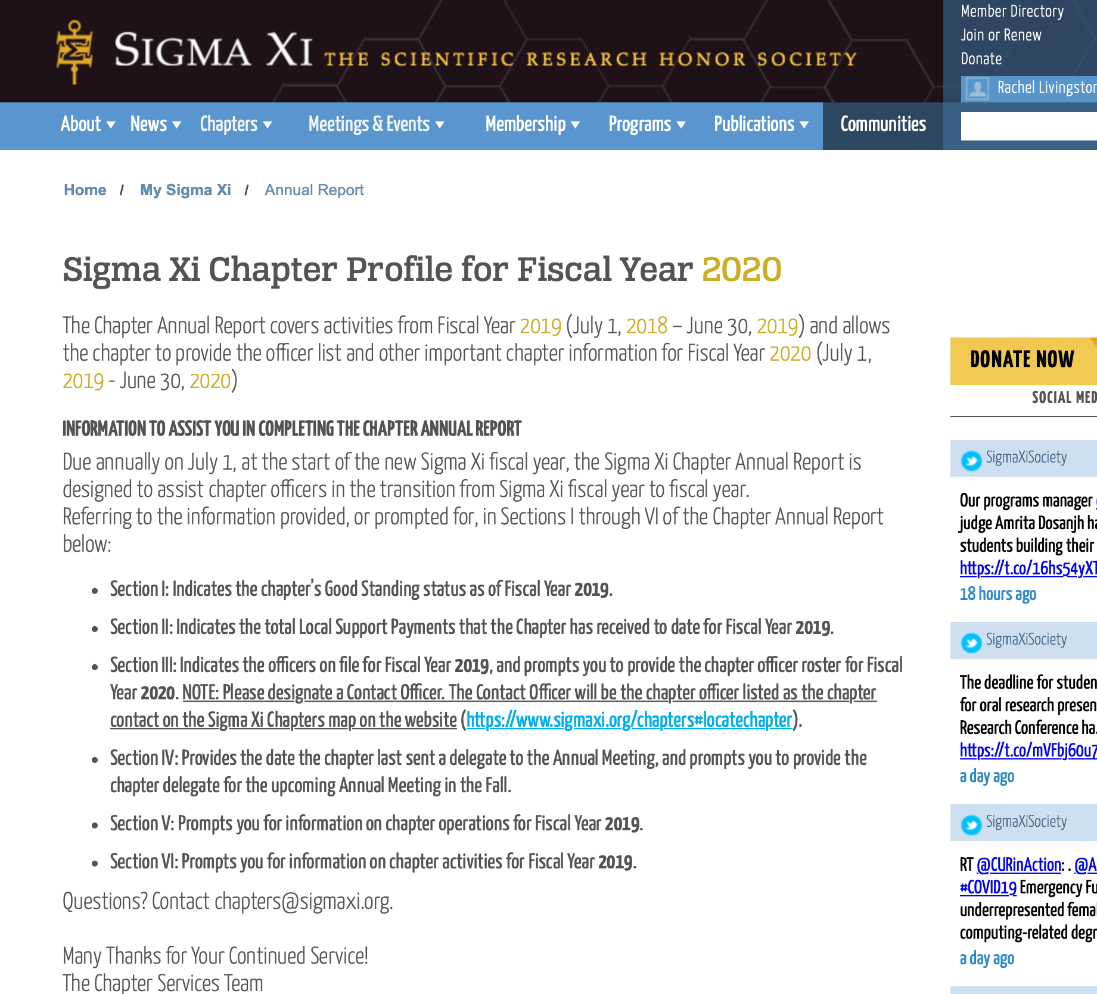
The Annual Report
Step 1:
Take a look at the report in advance of actually filling it out
This will help you become acquainted with the information you need to discuss with your chapter officers

Slide 5
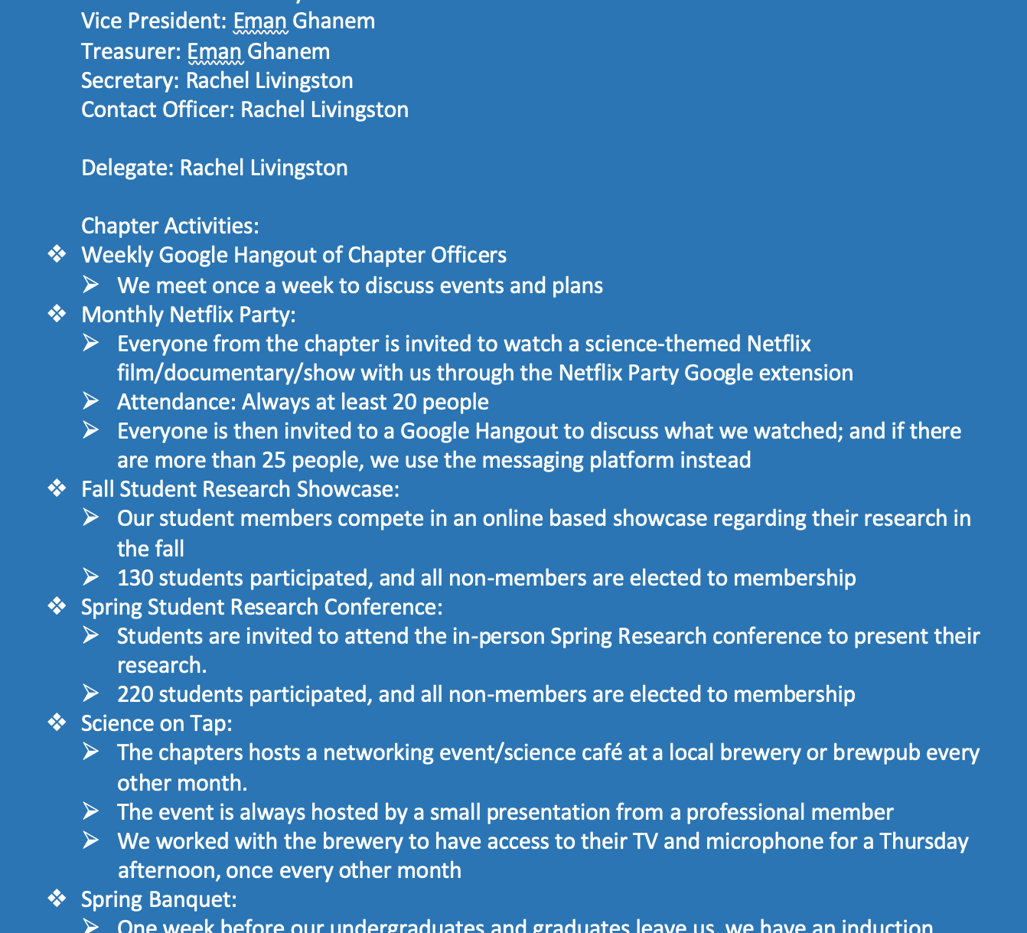
The Annual Report
Step 2:
Write down and have prepared all of the information you might need:
i.e. chapter officers, past events, your delegate

Slide 6
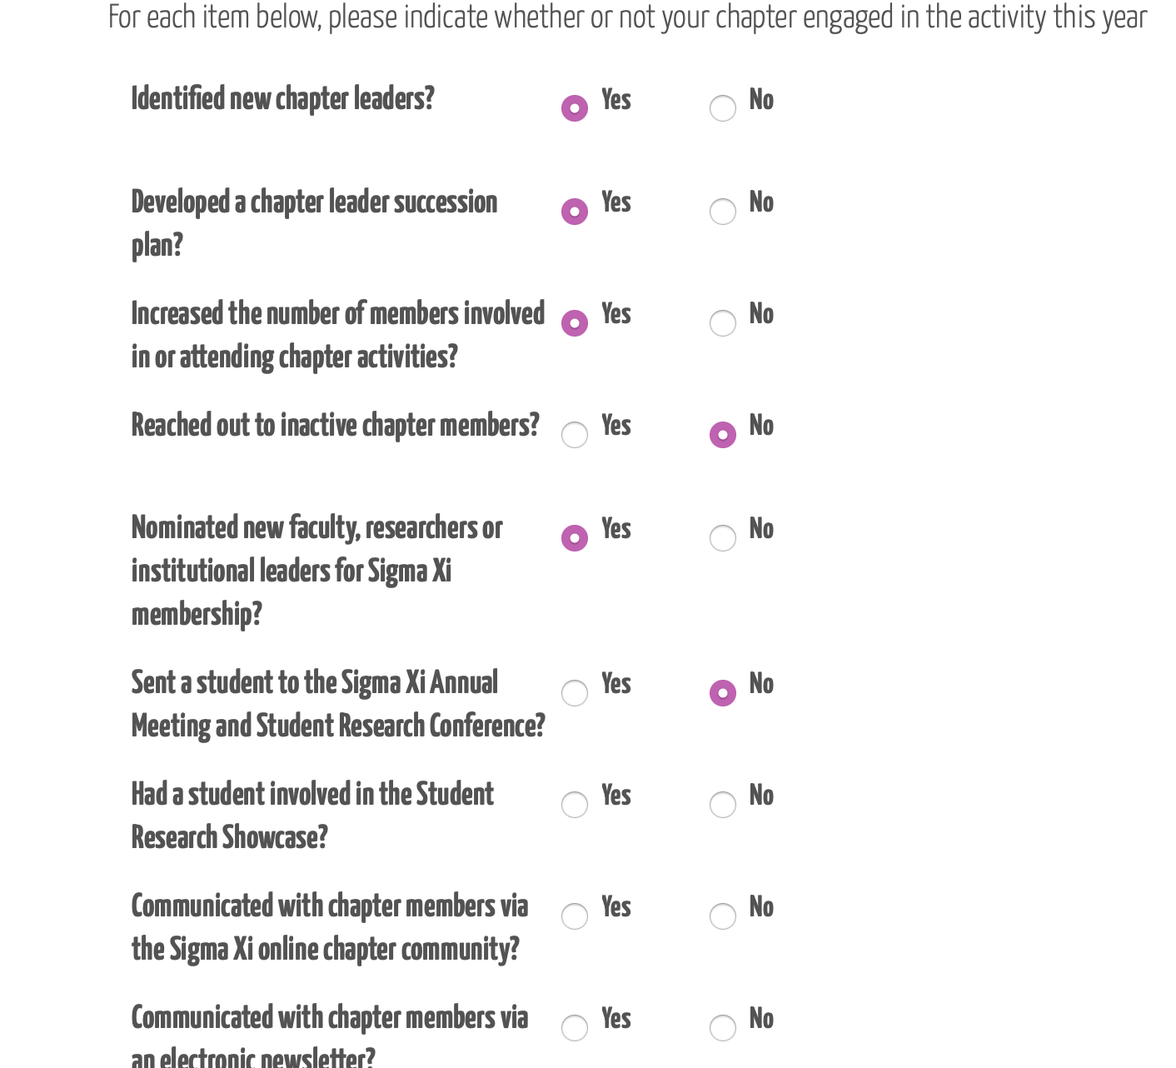
The Annual Report
Step 3:
Fill out the Annual Report

Slide 7
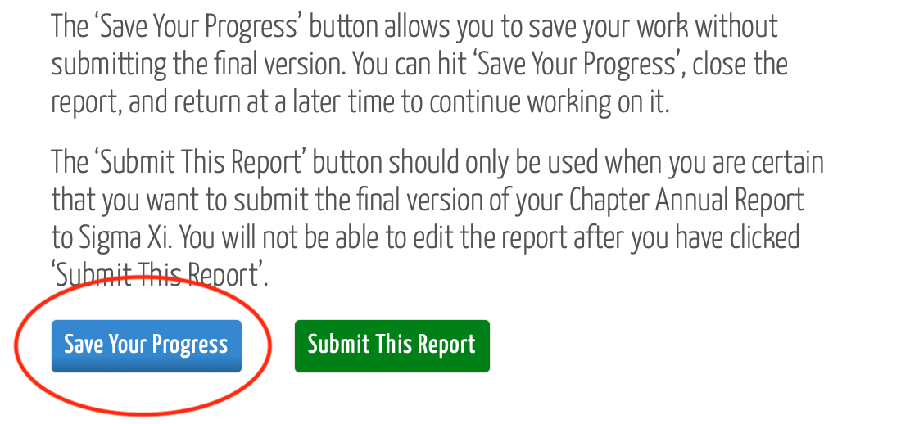
The Annual Report
Step 4:
Save the Annual Report

Slide 8
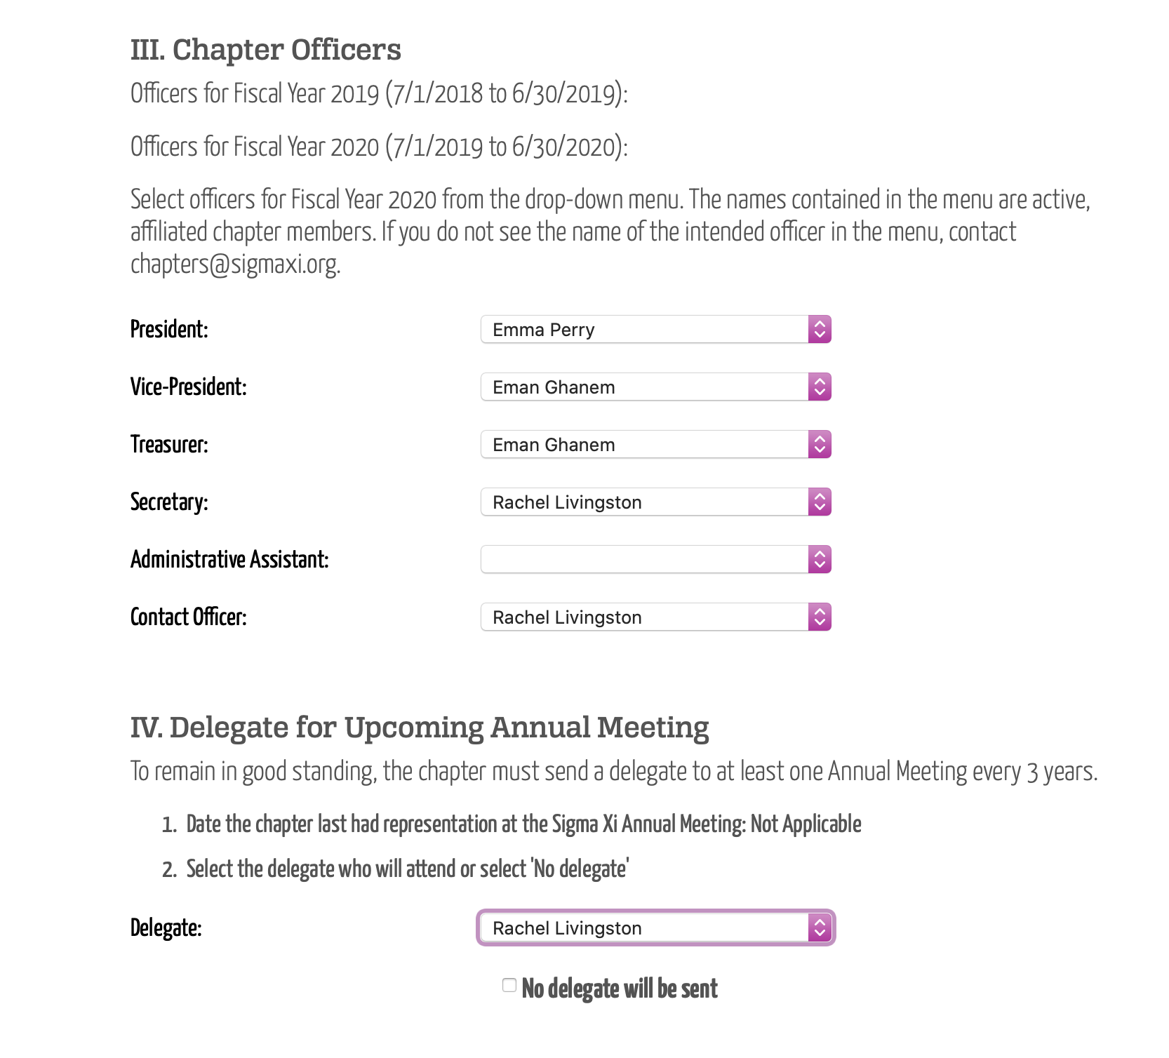
The Annual Report
Step 5:
Review your Annual Report

Slide 9
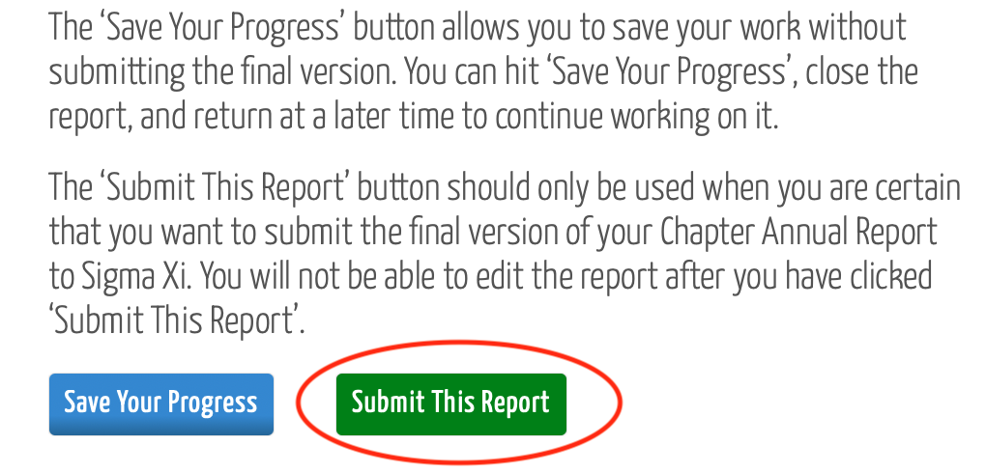
The Annual Report
Step 6:
Submit the Annual Report
You will get an email, and so will chapters@sigmaxi.org

Slide 10
Come Back Again!
Join us for Future Chapter Chats:
(Each of these chats are subject to change)
April 22: Treasurer’s Report
July 2: Chapter Management and Onboarding
September 1: Chapter Programming and Communication
December 2: Chapter Grants
You can find previous Chapter Chats in the Officer Toolkit!

